Slide 1
PyCon 2019
Ever wondered which company best suits you?

Slide 2
Myself
Education
BITS Pilani (B.E. in Civil Engineering)
ESSEC Business School (Master in Data Sciences and Business Analytics)
Work Experience
TESCO
eBay
Domain Knowledge
Banking
Promotions and Coupons
Pricing (delivery charges & commission on sale of items)
Incremental Analysis
A/B Testing

Slide 3
How do I find the best company ?
Define “Best”
Salary ?
Work-Life balance ?
Management and Manager ?
Career Growth ?
Campus and Cafeteria ?
Promotions and Hikes ?
State of Technology used ?
Transport ?
Few numbers can answer.
Text would give the nitty-gritty details.
Notes:
Traditional way – LinkedIn. But its limited to maybe 5 responses. Since a company is defined by 5 people, usually you are going to get a biased opinion.

Slide 4
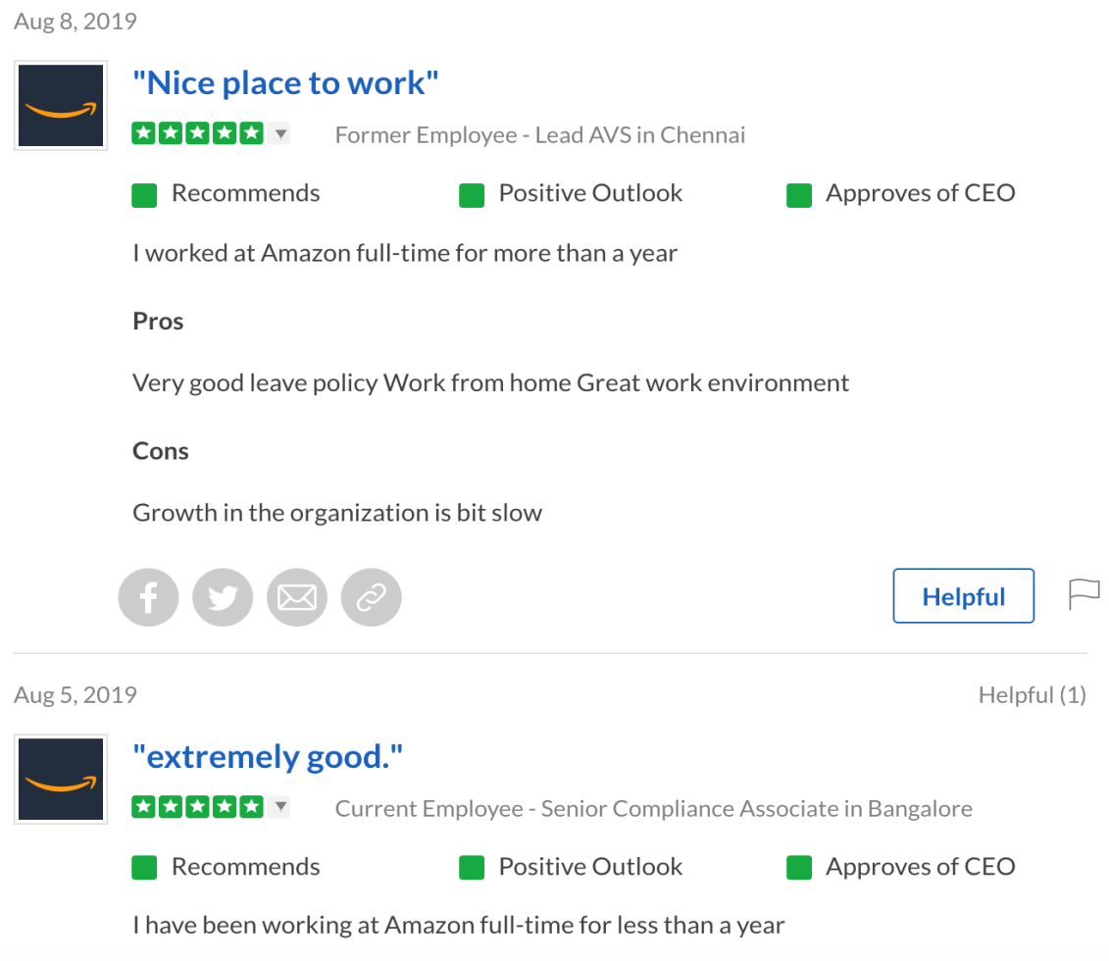
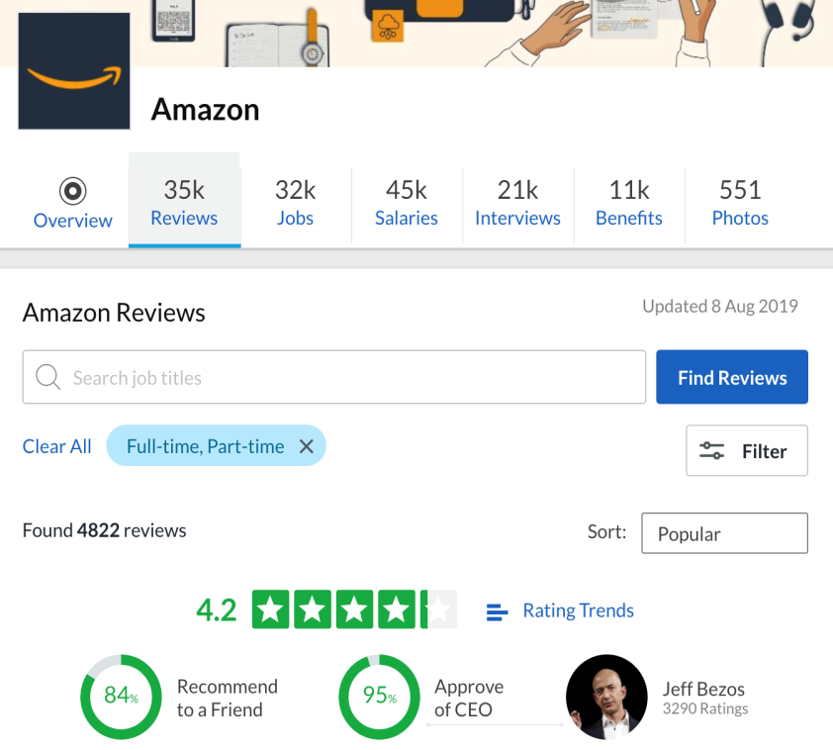
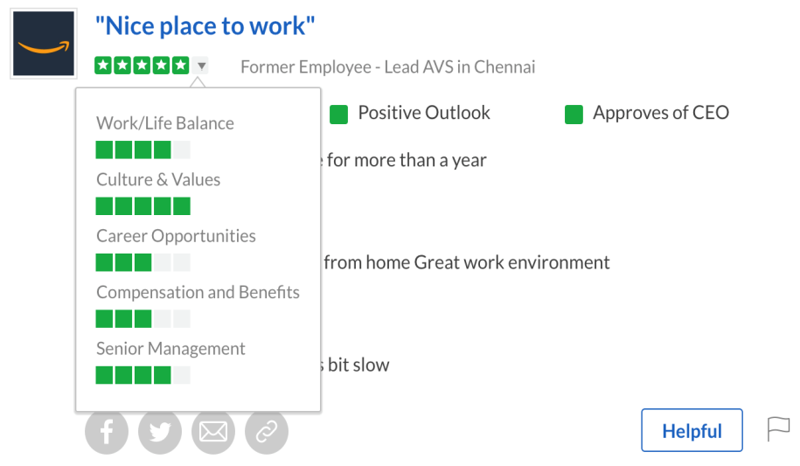
Leverage from Glassdoor website

Slide 5
Methodology
Web-scrape
Insights from numerical data (salary/ratings/work experience)
Trends
Slice & Dice
Insights from text (Pros/Cons/Advice to Management)
Form tf-idf vector matrix
Dimensional reduction
Cluster reviews
Identify key words to label topics

Slide 6
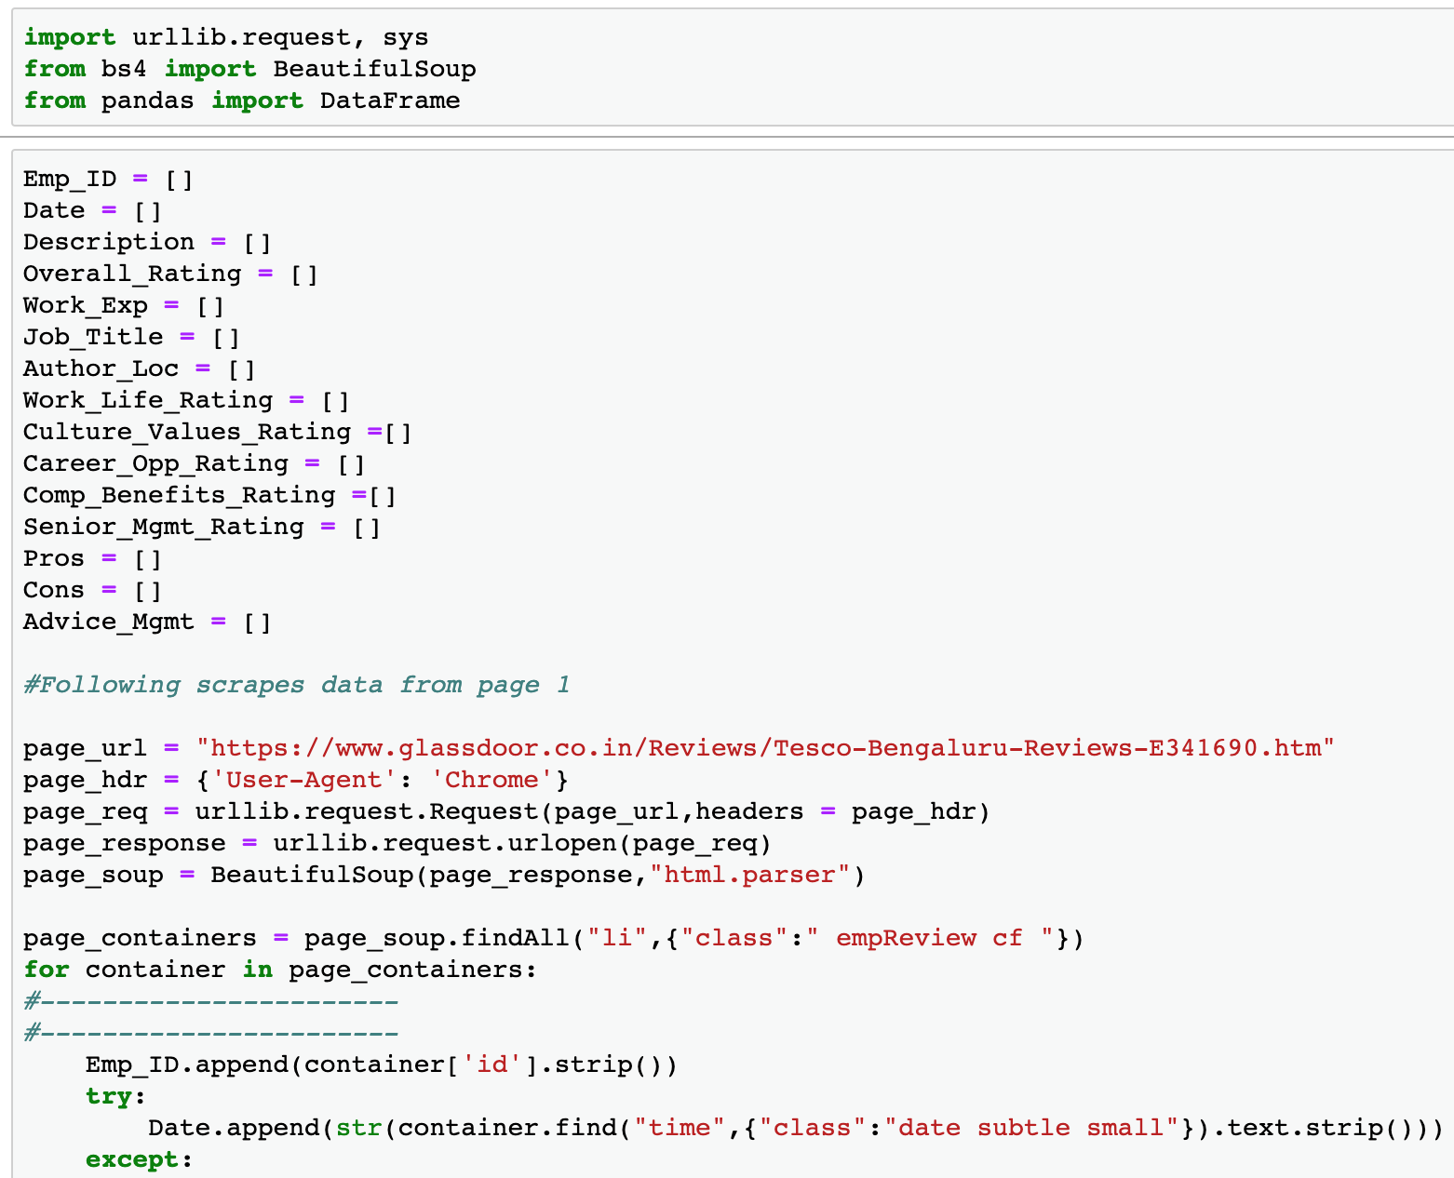
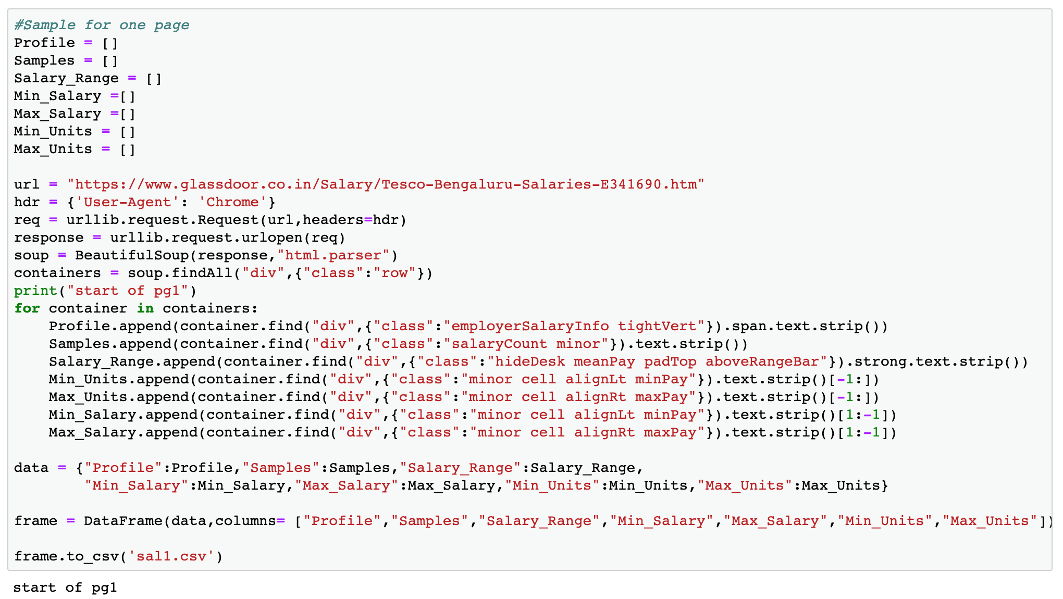
Web-Scrape Reviews, Ratings and Salaries

Slide 7
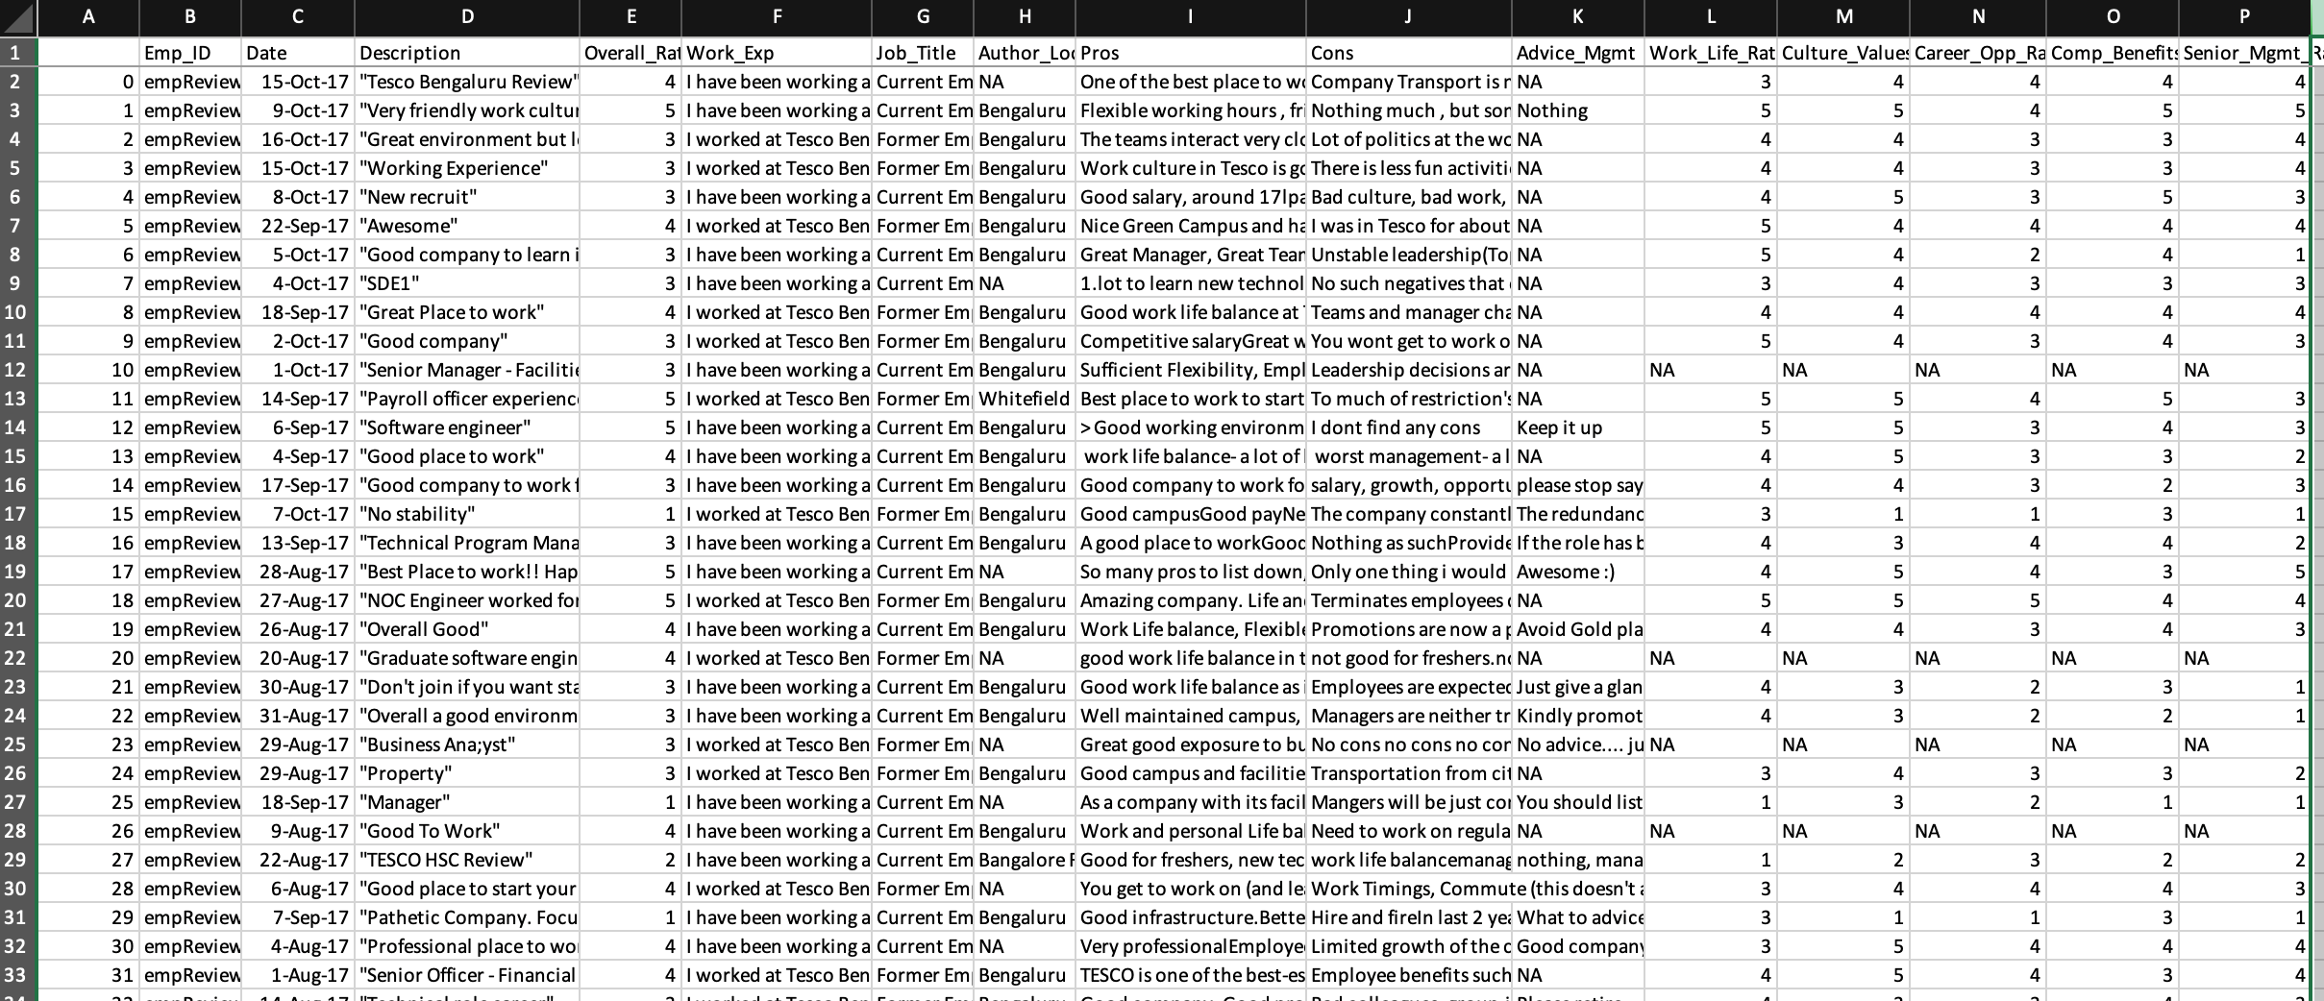
Website Data in Rows and Columns – Reviews & Ratings

Slide 8
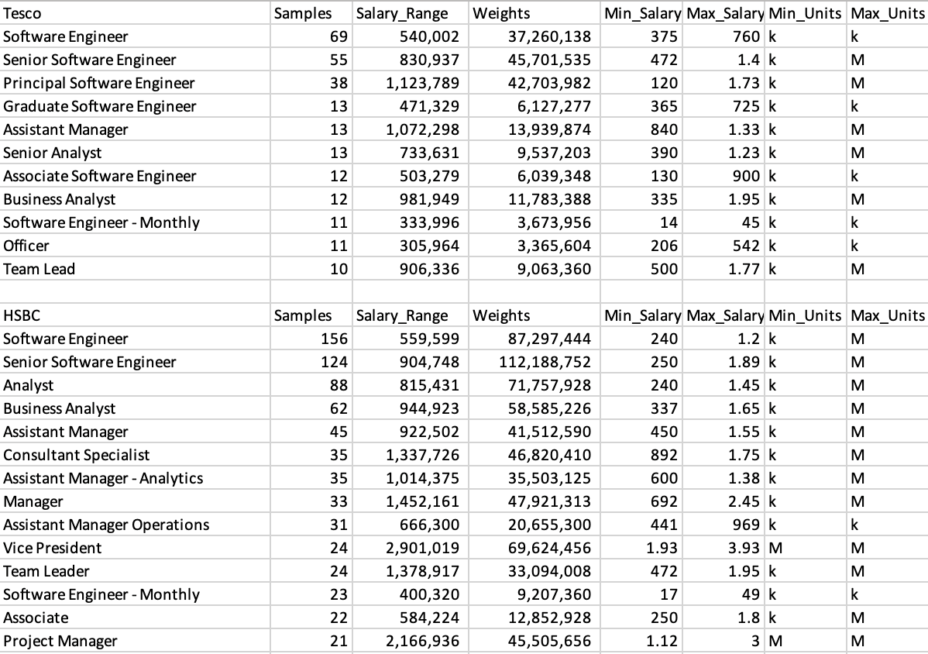
Website Data in Rows and Columns - Salaries

Slide 9
Tesco’s overall compensation is lower than its immediate competitors, also its rating is the least amongst all
Tesco Rating
3.3
HSBC Rating
3.5
Target Rating
3.7
Amazon Rating
3.7

Slide 10
Overall rating has continuously improved since 2015, however it declined drastically in the past few months
Career opportunities and senior management have a higher impact on the overall rating in comparison with compensation/benefits and work life balance

Slide 11
Employee ratings improve with work experience; there is scope for improvement in Technology and Analytics job functions

Slide 12
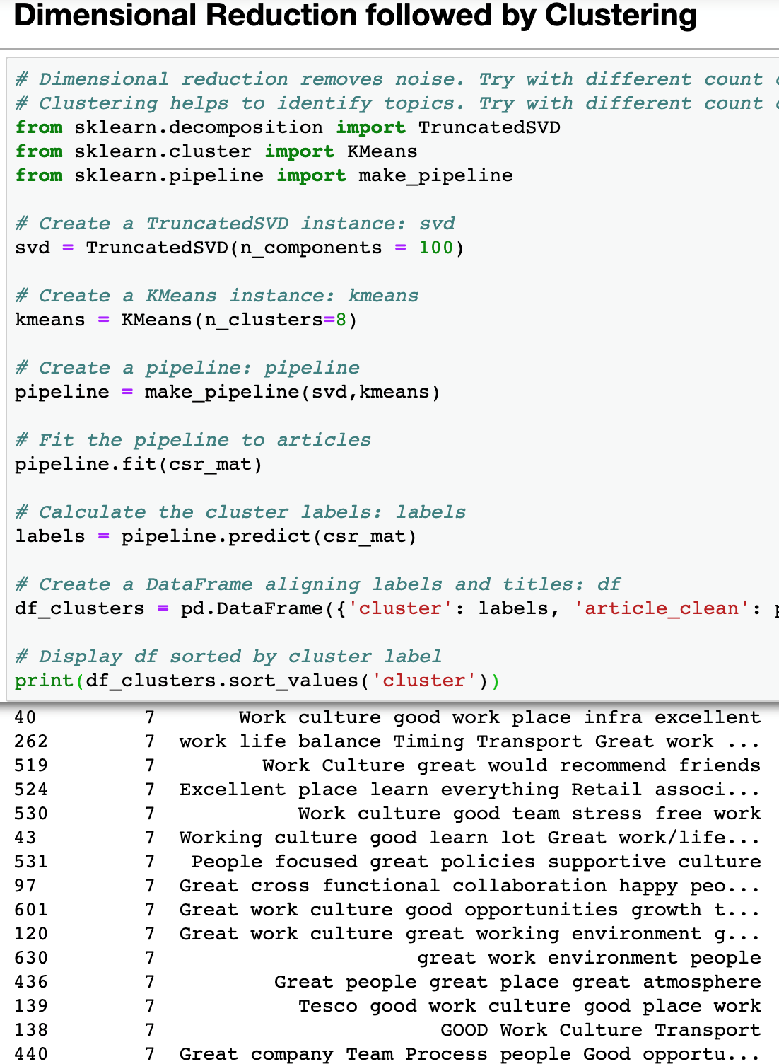
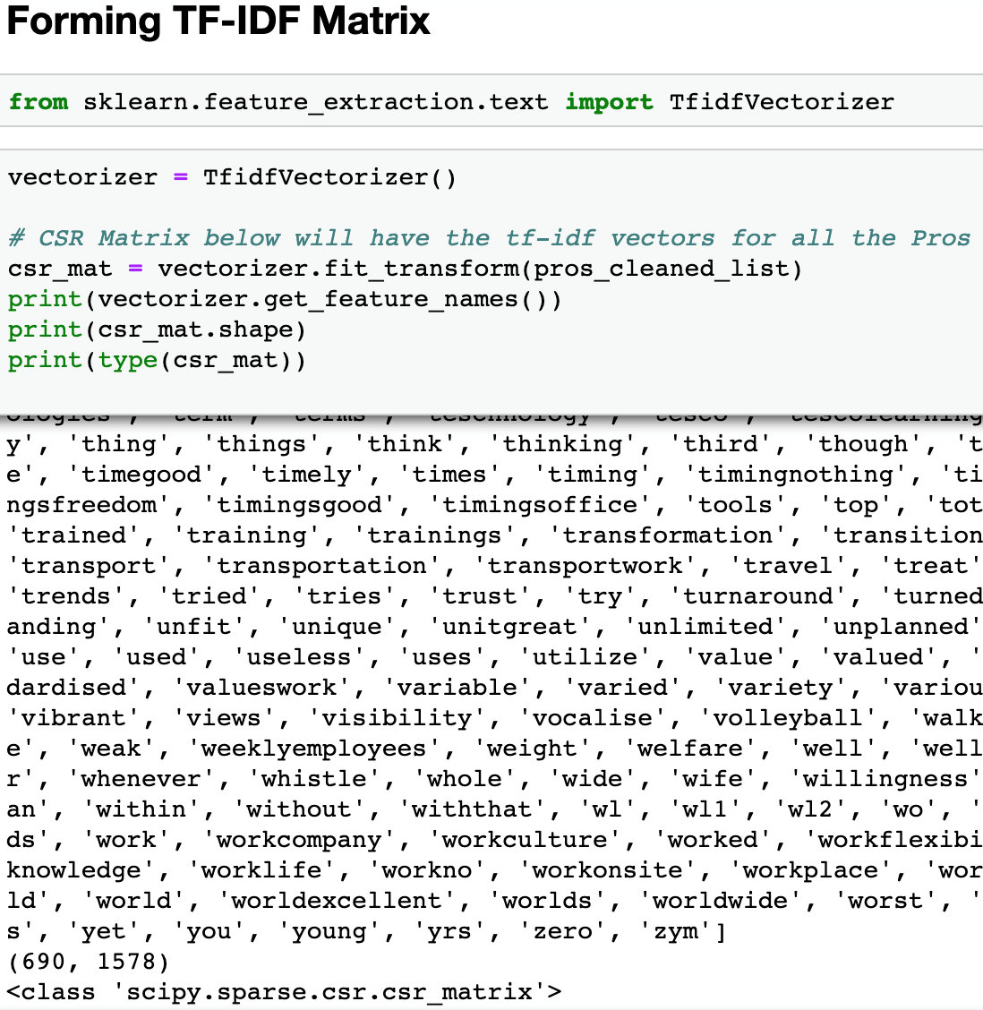
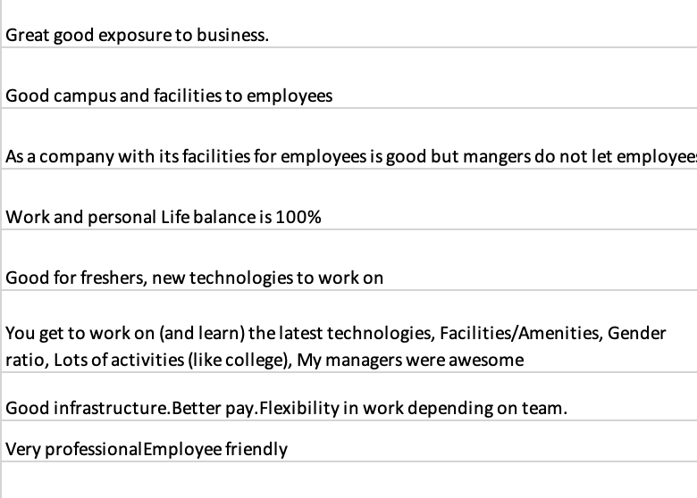
Planning to Cluster reviews to get the big picture ?
Sample set of Pros
Notes:
Each review is mixed up with one or more topics. So any clustering method would not give us the right cluster. This is one example where you just cant apply the ML algorithms and expect them to throw the results that you want to see.

Slide 13
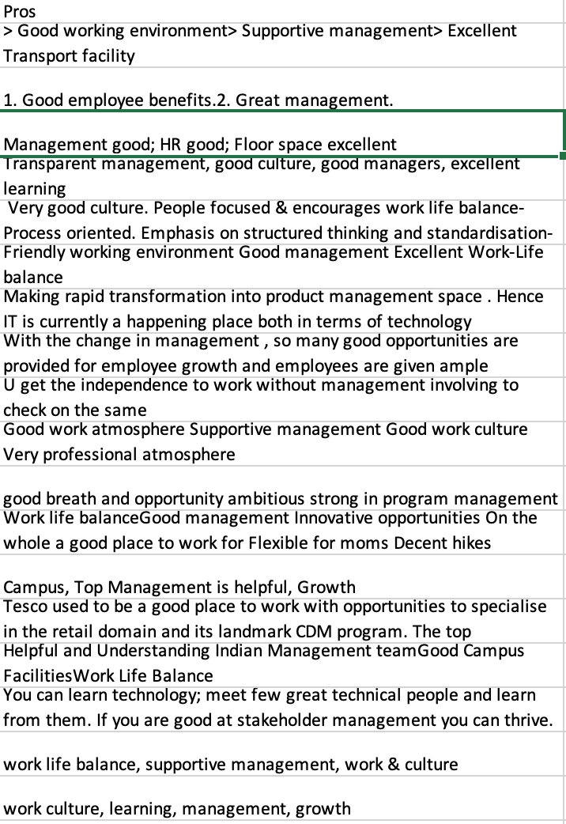
Simple count works well here...
Methodology
Identify the key words that could define a topic
Map reviews to topic if there is at least one key word in the review
One to many mapping is thus possible
For example, adjacent image is collection of all positive reviews on “Management”. But they are also the positive reviews on “Work Culture” and “Job Satisfaction”

Slide 14
Management, promotions and hike are the biggest concerns for colleagues; while they are more satisfied with campus facilities, cafeteria and work life balance

Slide 15
Recommendations from topic labels
We would need to continue the work from home, flexible timings policies
Improve communications about severance package during inevitable circumstances
Work on communications about rewards and recognition
Building a grievance tool for colleagues to escalate work place ethics violations
Introduce more transparent structure on promotions
Create opportunities for all teams to get more exposure in technology

Slide 16
Q&A ☺

